Slide 1
Day 06
Horn's Method and Fiducial Registration Error

Slide 2
Issues
the use of the least-squares criteria assumes
identically distributed noise in each point
isotropic noise in each point
more accurate (although more complicated) algorithms are available if these criteria are not met
Matei and Meer, IEEE PAMI, 28(10), Oct 2006

Slide 3
Characterizing Error
most commonly used noise distribution is the zero-mean Gaussian (or normal) distribution
mean (location)
covariance (spread)

Slide 4
Characterizing Error
in 1D
standard deviation
variance

Slide 5
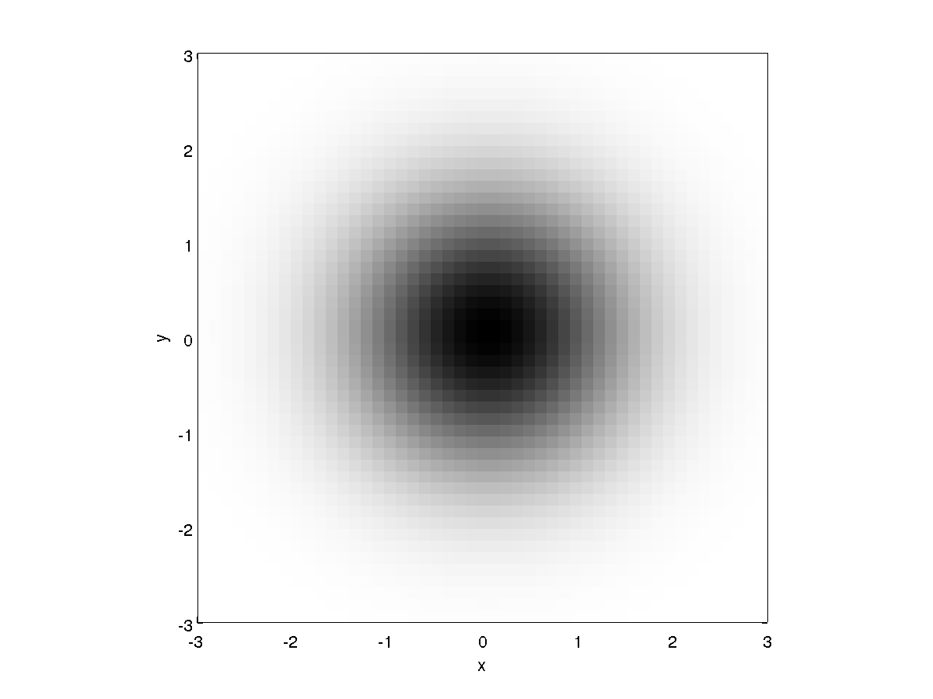
Characterizing Error
in 2D
isotropic

Slide 6
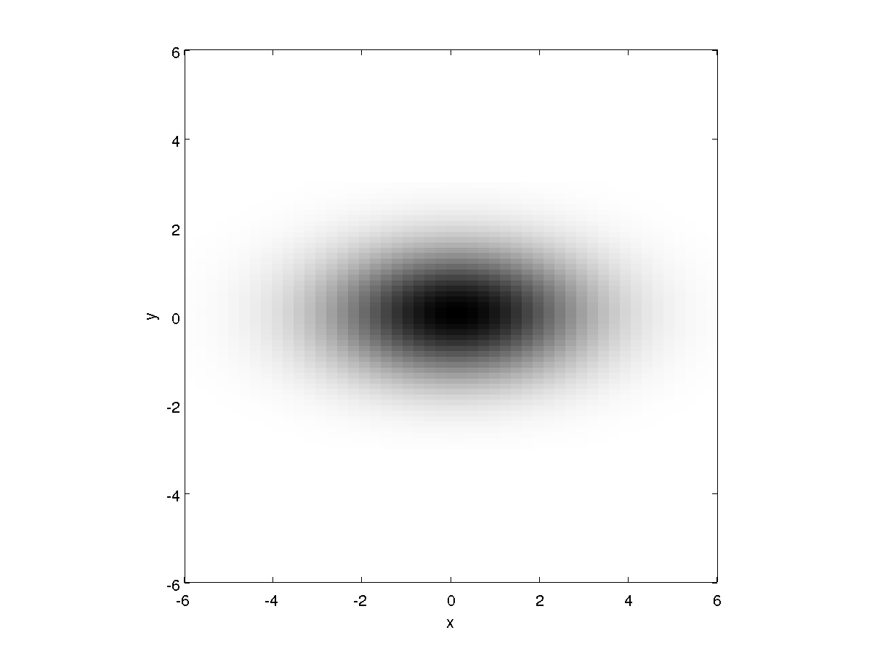
Characterizing Error
in 2D
anisotropic

Slide 7
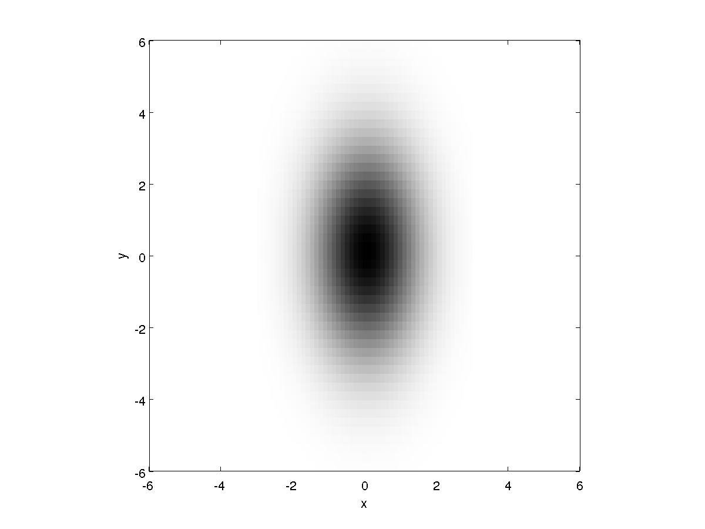
Characterizing Error
in 2D
anisotropic

Slide 8
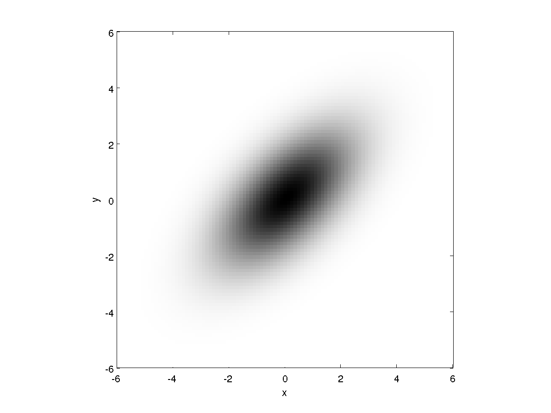
Characterizing Error
in 2D
anisotropic

Slide 9
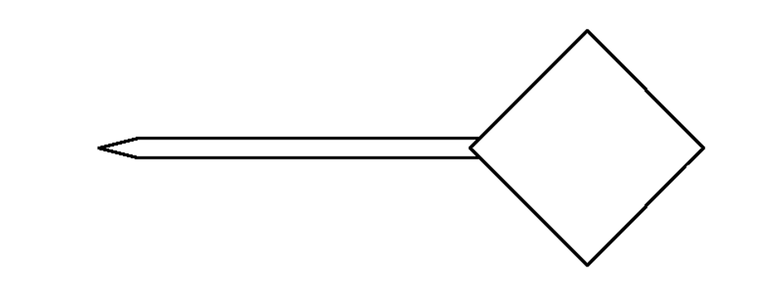
Registration Error
model pointer
Suppose we have a tracked pointing stylus with a DRB having 4 fiducial markers.

Slide 10
Registration Error
actual pointer
Because the of measurement errors in the tracking system, the locations of the
fiducial markers cannot be measured exactly. The error between the actual and
measured marker locations is called the fiducial localization error (FLE).

Slide 11
Registration Error
minimize : Σ ( FRE_{i} )²
actual pointer
model
pointer
fiducial registration
error ( FRE_{i} )
When the model pointer is registered to the measured pointer, the FLE will
lead to some error in the estimated rotation and translation. The residual
errors in the fiducial locations after registration is called the fiducial registration
error (FRE).

Slide 12
Registration Error
actual pointer
target registration
error (TRE)
Usually, we are interested in points that are not fiducial locations. Any such
point (not used for registration purposes) is called a target. The error between
the true target position and registered target position is called the target
registration error (TRE).

Slide 13
Horn's Method and FLE
Horn's method (and all other ordinary least-squares methods) is optimal when FLE is identical and isotropic
{L}
{R}

Slide 14
Horn's Method and TRE
early methods of studying the behaviour of TRE relied on simulation studies
IEEE Transactions on Medical Imaging, vol. 16, no. 4, Aug. 1997
Given a set of registration points {P} = {p₀, p₁, ..., p_{n-1}}, a target point t, and an FLE variance σ ²:
define noise

Slide 15
Horn's Method and TRE
repeat 10,000 times
create a noise copy {Q} of {P} where
register {Q} to {P} using Horn's method to obtain the rotation R_{j} and translation d_{j}
compute the registered target location
compute the squared TRE
compute the root mean squared (RMS) TRE

Slide 16
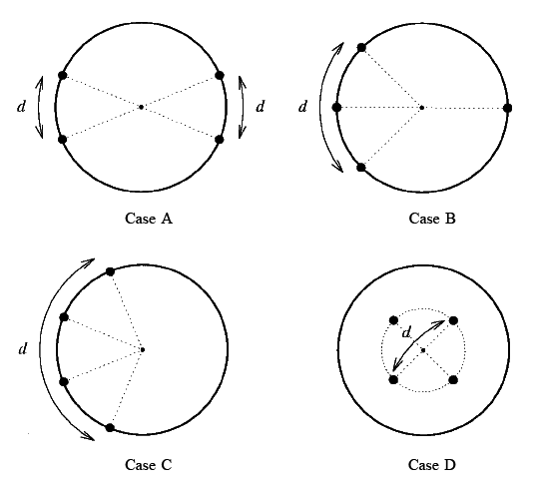
Horn's Method and TRE
simulations performed for different configurations of markers

Slide 17
Horn's Method and TRE

Slide 18
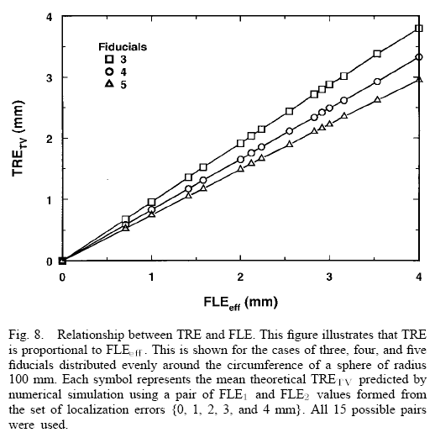
Horn's Method and TRE
simulation of TRE vs FLE

Slide 19
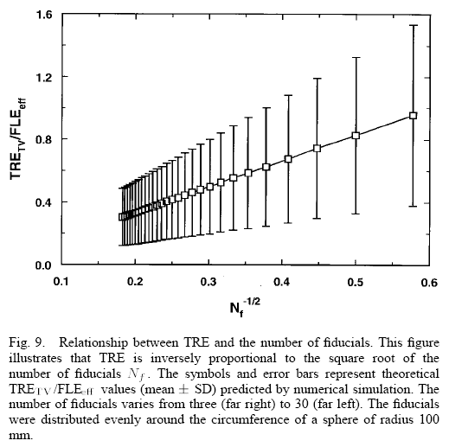
Horn's Method and TRE
simulation of TRE vs number of markers

Slide 20
Horn's Method and TRE
summary of results:
TRE depends strongly on configuration of markers
TRE²
TRE²

Slide 21
Analysis of TRE
Fitzpatrick, West, and Maurer Jr performed a statistical analysis of fiducial registration (assuming identical isotropic FLE)
IEEE Transactions on Medical Imaging, vol. 17, no. 5, Oct 1998
t target location
n number of markers
d _{k} distance between the target and the k ^{th} principal axis
f _{k} RMS distance between the fiducials and the k ^{th} principal axis

Slide 22
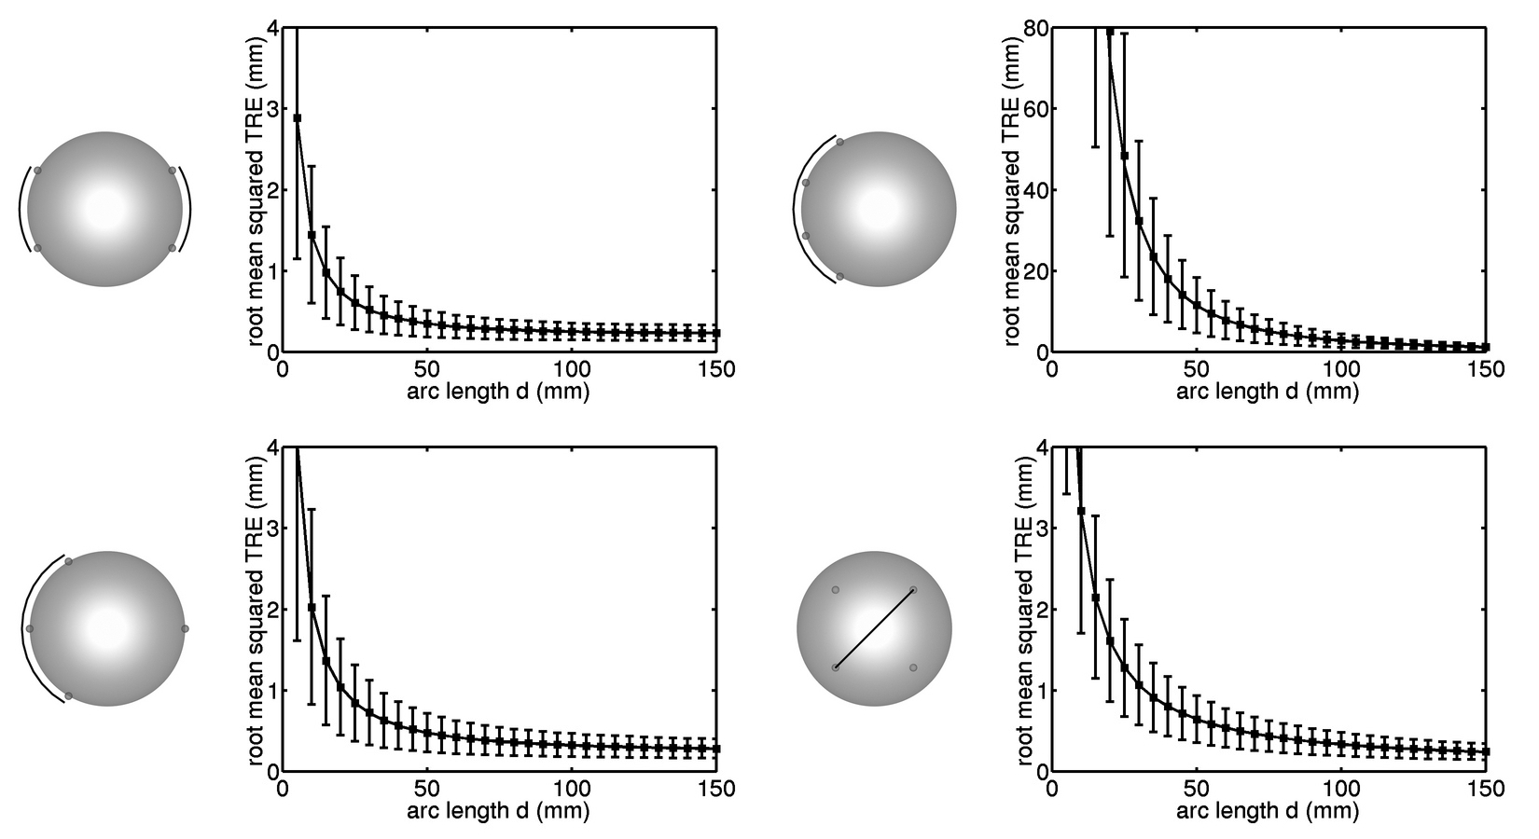
Analysis of TRE
TRE for different configurations of markers

Slide 23
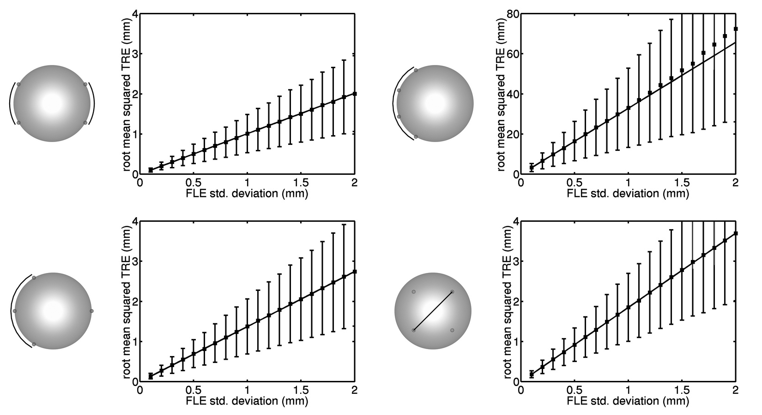
Analysis of TRE
TRE versus FLE

Slide 24
Analysis of TRE
other interesting results
FRE is independent of the marker configuration!
if you compute the TRE for the fiducial markers you get
i.e., a small FRE implies a large TRE at the marker location!
FRE is poor indicator of registration quality

